Slide 1
1. git flows

Slide 2
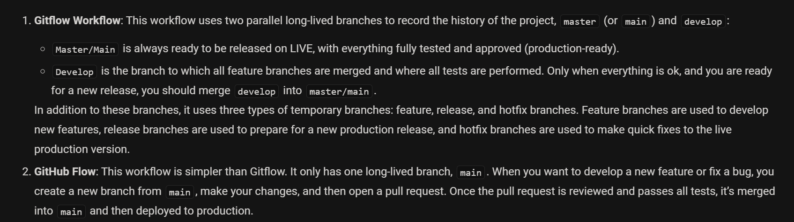
2. what

Slide 3
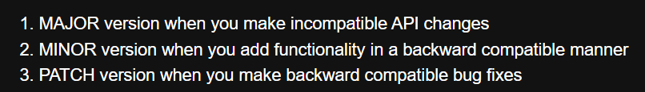

3. versions
what
versions

Slide 4


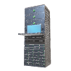
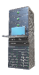
4. flow
remove:
release
hotfix
support
branch:
develop
major/minor cycle
new
version
repeat
code
software
4
bugfix
multiple
1
3
feature
6
develop
5
develop
branch
release
branch
2
merge
hotfix
cherry pick
7
old version
commit
support
staging
acceptance
production
commit
main
deploy
v1.0.0
v1.0.1
v1.0.2
v1.1.0
staging
production
environment
patch cycle
new
patch

Slide 5
5. reference
git flow

Slide 6
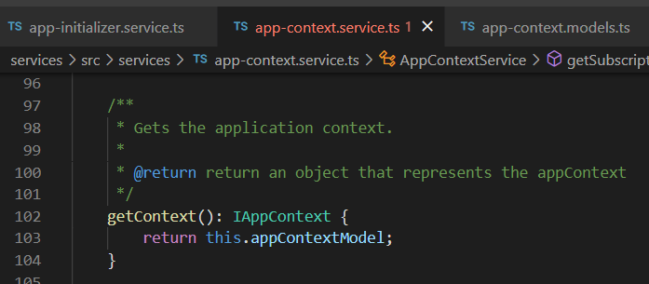





Z. template
new project
ExecuteAsync
square post-it
download
exe
download
exe
why
A slash
followed
by
two consecutive asterisks
D:\A1_research\C2_c0dice\B1_jmeter\A1_install
functionalities
introduction
build-exe
entity framework plus
zig help
⊂
4
every key-frame
defines the operation
deploy

